Slide 1
DESIGNING CIRCUIT DIAGRAM AND SCHEMATICS FOR TRANSMITTER SIDE Presented by :- Virender Singh (C0762540)

Slide 2
What is Schematics?
It is the representation of the element of the system using abstract, graphic symbols rather than realistic pictures. It can provide the details that are not relevant to the key information. It may include oversimplified elements in order to make this essential meaning easier.
In an electronic circuit diagram the layout of symbols may not look anything like the circuit as it appears in the physical world but instead the schematic aims to capture on more general level the way it works

Slide 3
Use of Schematics in Electrical and Electronic Industry
Schematics in Electrical and electronics industry is often used to describe the design of the equipment. They are often used for the maintenance and repair of electronic and electromechanical systems. Earlier the schematics were done by hand using standardized templates but nowadays they are mostly done using Electronic Design Automation software (EDA).
Until 1980s the schematics were the only formal representation for the circuits but with the recent technology, other representations were introduced and specialized computer languages were developed so the traditional schematics are becoming less practical.

Slide 4
Uses of Schematics in Electrical and Electronics Industry
For electronic circuits the schematics are prepared by designers using EDA (Electronic Design Automation) tools known as Schematic capture tools or Schematic entry tools. Usually they are integrated into whole design flow and are linked to the other EDA tools for verification and simulation of circuit under design.
Programmable Logic Controllers (PLC) can be programmed using ladder diagrams.

Slide 5
Use of Schematics in Electronic and Electrical Industry
In electric power systems design, a schematic drawing called as one line diagram is frequently used to represent substations, distribution systems or even whole electrical power grids. In these diagrams they simplify and compress the details that would be repeated on each phase of a three phase system, showing only one element instead of three. Another type of diagram used for power systems is three line diagram.

Slide 6
Uses of Schematics in Electronic and Electrical Industry
For one line diagram, if the system is balanced an equivalent per phase schematic diagram can be obtained. If all of parameters are represented as impedances and voltage sources then that schematic diagram is called Impedance diagram but if parameters are represented as admittances and current sources then it is called Admittance diagram.
If power system is unbalanced but it is linear then Fortescue theorem can be applied. In this way from one linear diagram, three different per phase schematic diagrams are obtained known ass Positive, Negative and Zero sequence diagram.

Slide 7
Softwares used for Schematics
1- Circuit Maker
2- Microsoft Visio
3- Easy EDA
4- Fritzing
5- Eagle
6- OrCAD
7- gEDA
8- SmartDraw
9- KiCad
10- CircuitLab
11- XCircuit

Slide 8
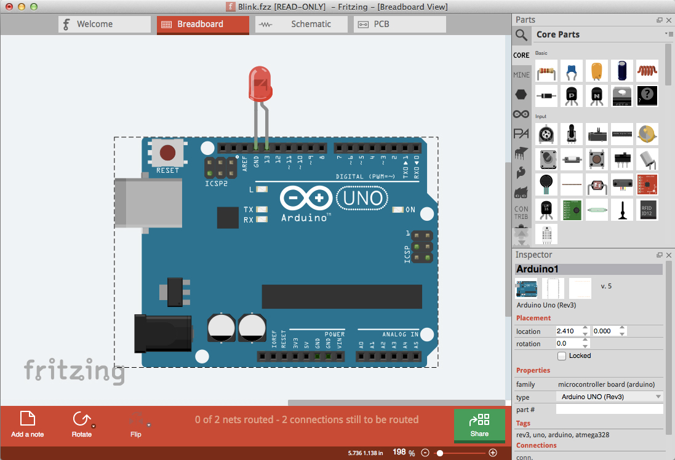
Fritzing Software
Fritzing is an open source initiative used for developing CAD software for the design of electronics hardware to support designers to move from experimenting with prototype to building a more permanent circuit. It is basically seen as EDA tool for non- engineers.

Slide 9
Goals of Fritzing Software
It is mainly created for processing programming language and Arduino microcontroller. It allows the designer to document their Arduino based prototype and create a PCB layout for manufacturing.
It can be seen as EDA tool as the input metaphor is inspired by the environment of designers while the output is focused on accessible means of production.
It has code view option where we can modify code and upload it directly to an Arduino device.

Slide 10
How to install Fritzing?
Go on google and search Fritzing
We will see that for installing the Fritzing application they will be charging 6 to 8 euros.
Then we will have to search for the link from where we can download the software free of cost.
Then click on this link https://www.electroschematics.com/fritzing-software-download/
After clicking on this link we can install Fritzing free of cost.

Slide 11
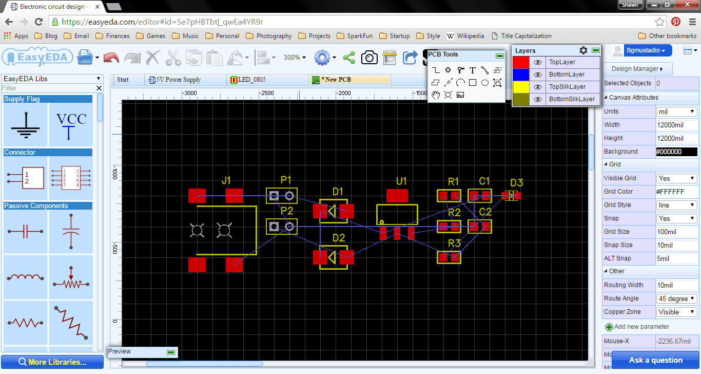
Easy EDA
Easy EDA is a web based EDA tool that enables the hardware engineers to design, simulate, share and discuss schematics, simulations and printed circuit boards. Features may include Bill of Materials, Gerber files and pick and place files and documentary outputs in PDF, PNG and SVG formats.

Slide 12
How to install EasyEDA ?
For installing EasyEDA we have to follow these simple steps:
Go on google and search https://www.google.com/search?client=firefox-b-d&q=EasyEDA
Then click on above link and click on EasyEDA
Then click on install button for downloading EasyEDA
If you don’t want to install EasyEDA in your laptop just click on EasyEDA designer. https://easyeda.com/editor
Here on clicking the above link just you can start there using it for free or we can perform our work online.

Slide 13
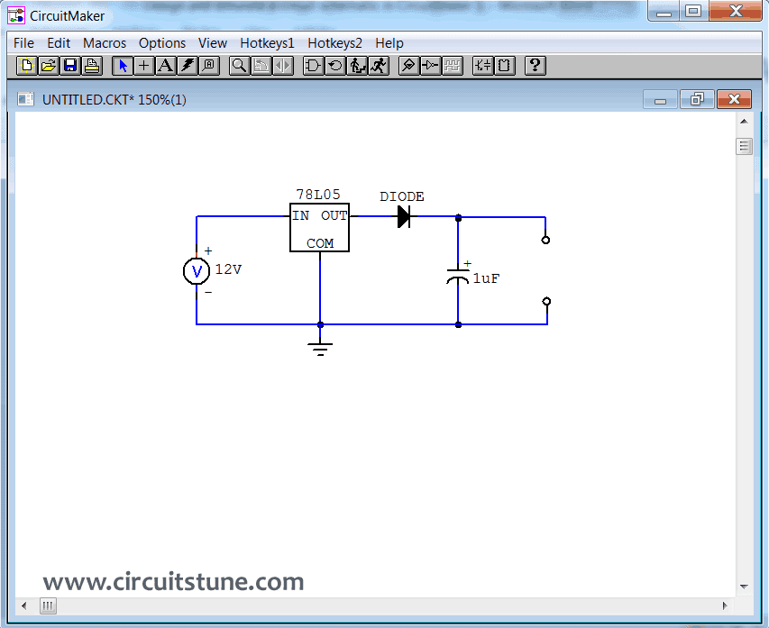
CircuitMaker
It is an electronic design automation software for the printed circuit board designs targeted at hacker and maker community. The hardware designed with it may be used for commercial and non commercial purposes without limitation. It also supports design rule configuration and real time design rule checking.

Slide 14
Microsoft Visio
It is an diagramming and vector graphics application. It is basically available in two editions such as Standard and Professional. The standard and professional edition share same interface but professional edition has additional templates for more advanced diagrams and layout
Professional edition features three additional diagram types as well as rules, validation and subprocess.
It is also offered as an additional component of an Office365 subscription.

Slide 15
Eagle
Eagle stands for Easily Applicable Graphical Layout Editor.
It is an scriptable electronic design automation with schematic capture, printed circuit board layout, auto-router and computer aided manufacturing features.
It also provides multi window graphical user interface and menu system for editing, project management and to customize the interface and design parameters.
It saves Gerber and Postscript layout files as well as Excellon and Sieb & Meyer drill files.

Slide 16
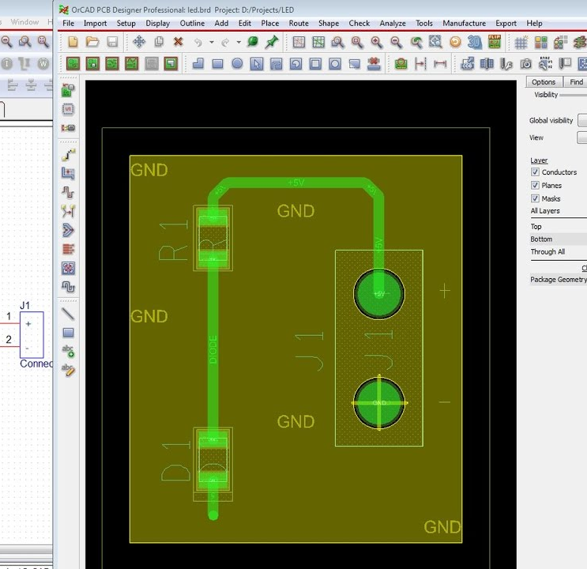
OrCAD
It is basically a software tool used primarily for electronic design automation. It is used to create electronics schematics and perform mixed signal simulation and electronic prints for manufacturing printed circuit board.
The name OrCAD reflects the company and its software origins Oregon+CAD

Slide 17
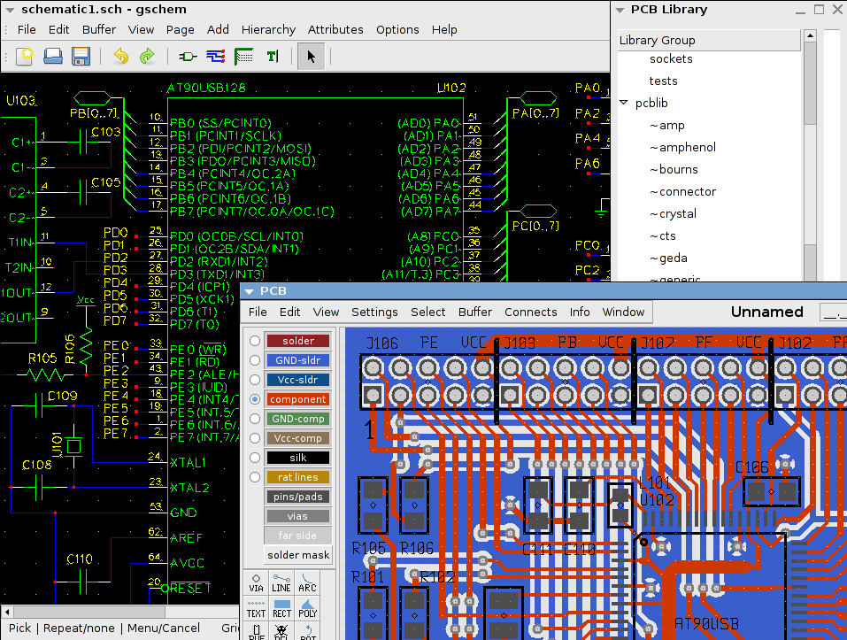
gEDA
Geda is an ECAD or EDA application suite. It is mostly oriented towards printed circuit board design.
The word Geda is a conjunction of GPL and EDA. The names of some of the individual tools in the gEDA suite are prefixed with letter g to emphasize that they are released under the General Public License.

Slide 18
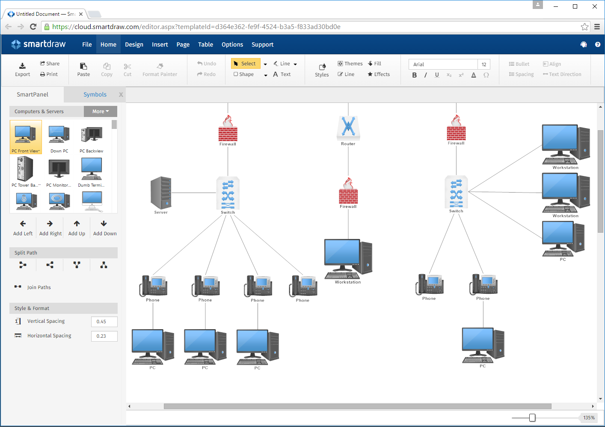
SmartDraw
It is an diagram tool used to make flowcharts, organizations charts, mind maps, project charts and other business visuals.
It has two versions : Online Edition and a downloadable edition for Windows desktop.
It integrates with Microsoft office products including Word, Powerpoint and Excel and applications like Google Docs and Google Sheets.
It is compatible with Google Drive, Dropbox, Box and Onedrive.

Slide 19
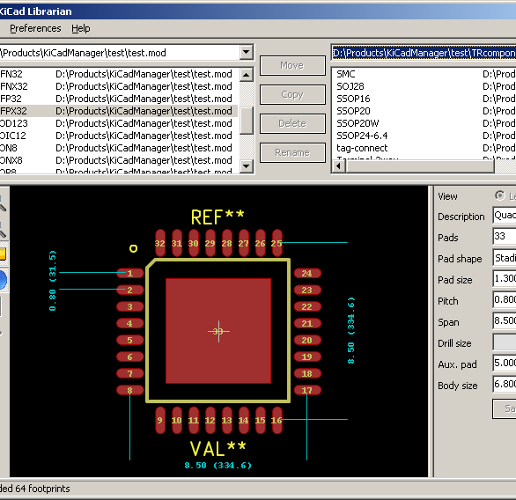
KiCad
It is free software for electronic design automation. It facilitates the design of schematics for electronic circuits and their conversion to PCB designs.
It features an integrated environment for schematic capture and PCB layout design. Tool exist within the package to create a bill of materials, artwork, Gerber files, and 3D views of the PCB and its components.
It is integrated for all stages of design process such as schematic capture, PCB layout, Gerber file generation and library editing.

Slide 20
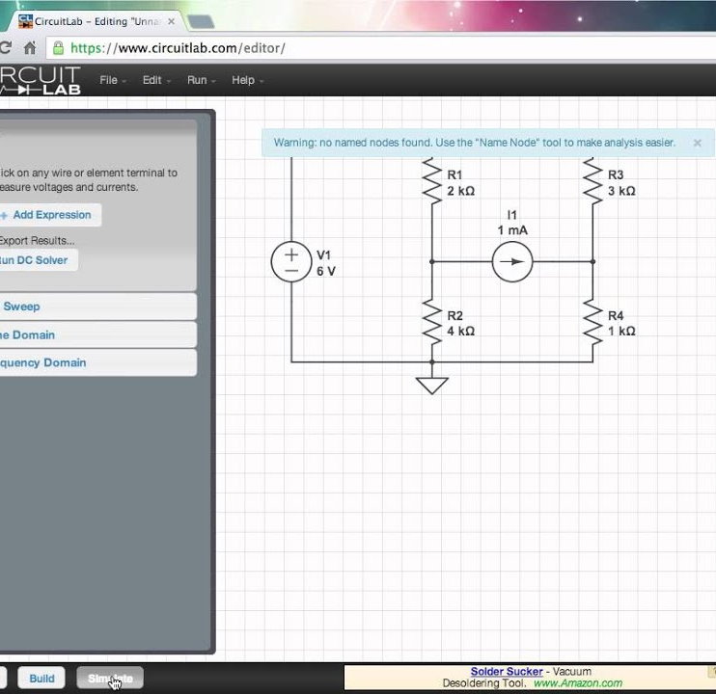
CircuitLab
It is platform that makes it easy for engineering, hobbyists and students to design, build and share circuits.
It was designed to be web app that could be utilized by electrical design engineers to draw and simulate a circuit without reading complicated legacy desktop software or any manual.

Slide 21
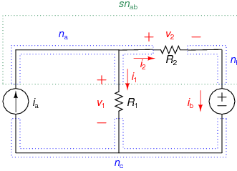
XCircuit
Xcircuit is used for drawing electrical schematics diagrams and related figures and production of circuit netlists through schematics capture.
It maintains flexibility in style without compromising the power of schematic capture.
Circuit components are saved in and retrieved from libraries which are fully editable.

Slide 22
Fritzing
Fritzing is an open-source initiative to develop amateur or hobby CAD software for the design of electronics hardware, to support designers and artists ready to move from experimenting with a prototype to building a more permanent circuit.
The software is created in the spirit of the Processing programming language and the Arduino microcontroller[5] and allows a designer, artist, researcher, or hobbyist to document their Arduino-based prototype and create a PCB layout for manufacturing.
The associated website helps users share and discuss drafts and experiences as well as to reduce manufacturing costs.

Slide 23
Concept About Fritzing
Breadboard View – Fritzing can present your circuit in breadboard view, making it easy to visualize how components will fit together and be wired together. Fritzing has a vast library of parts to represent all major components in the Breadboard view.
Schematic View – This is the traditional view of the circuit as represented in books. Frtizing has a large library of schematic parts to build up the Schematic View.
Printed Circuit Board View – A printed circuit board (PCB) consists of electronic components connected electrically on copper tracks laminated on a non-conducting substrate. This view is necessary to fabricate the PCB for the circuit.

Slide 24
Importing Libraries
Importing Beaglebone black libraries
Go to this website and click the 'View Raw' button to download the latest AdaFruit library.
https://github.com/adafruit/Fritzing-Library/blob/master/AdaFruit.fzbz
At the top left of the Fritzing application, click: File>Open>AdaFruit.fzbz
Once the library is imported, exit the Fritzing library. You will be prompted with a box. Make sure to save the changes to your library.

Slide 25
Importing Libraries for LCD touch
https://fritzing.org/projects/nextion-display
Go to the above link and download *fzz file for Nextion Touch display
Add libraries to the fritzing app
Exit
Relaunch

Slide 26
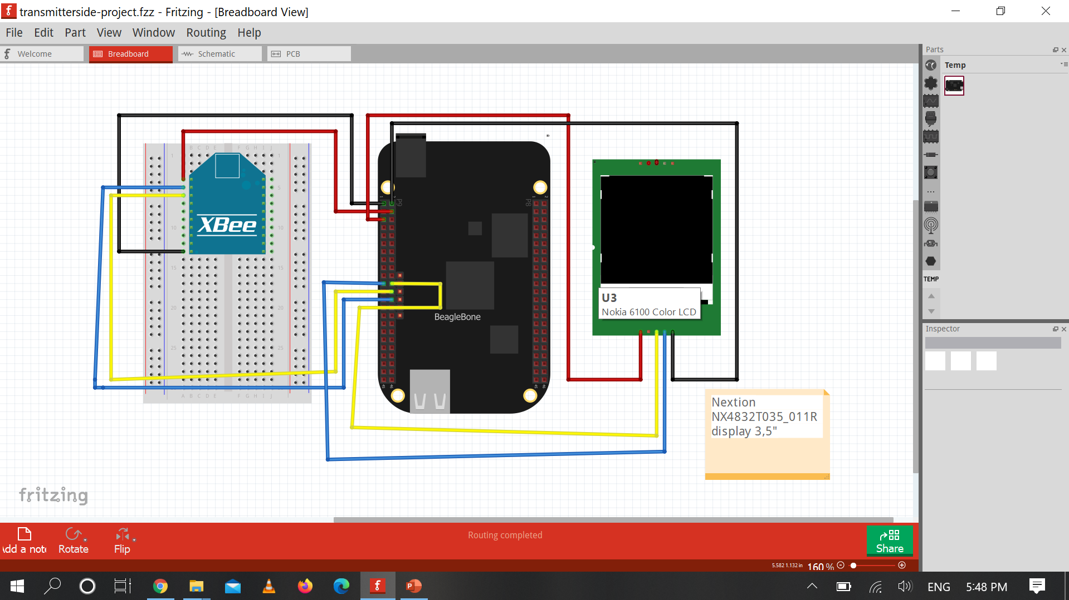

Slide 27
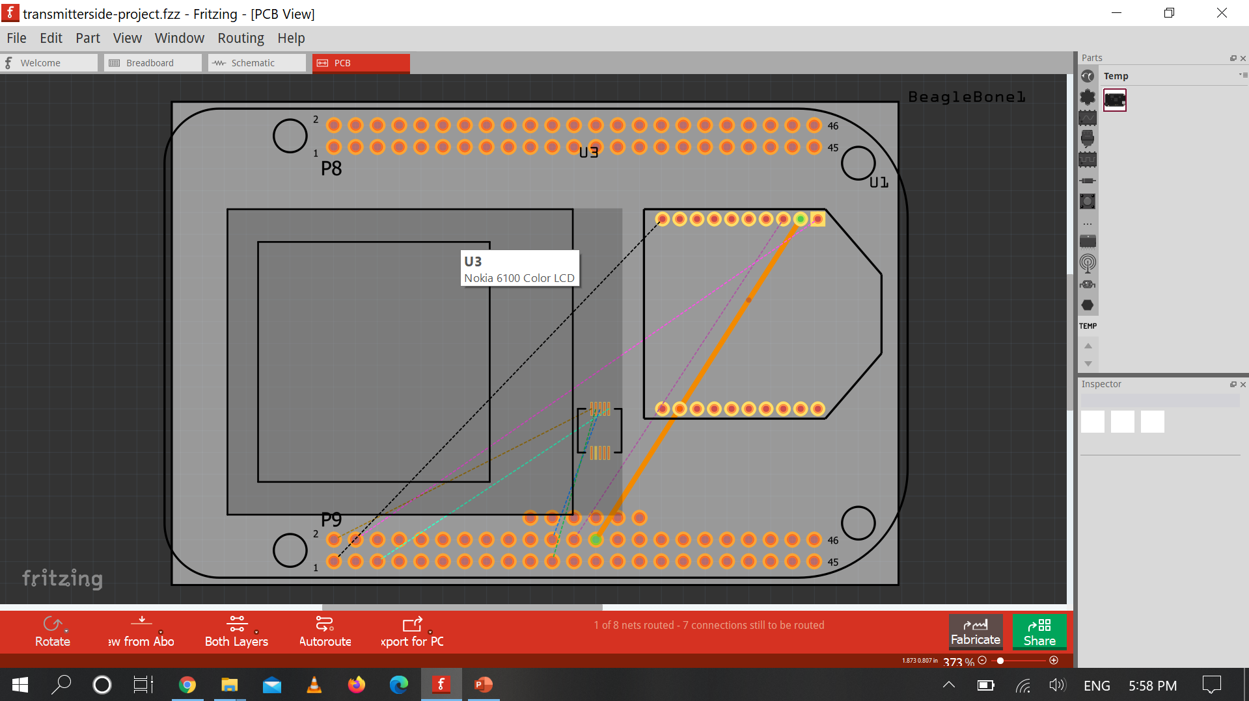

Slide 28
Refrences
https://en.wikipedia.org/wiki/Schematic...Schematics
https://www.seeedstudio.com/blog/2017/03/13/pcb-design-software/.... Softwares for Schematics
https://www.pannam.com/blog/best-pcb-design-software-tools/....Softwares for schematics
https://en.wikipedia.org/wiki/Fritzing.....Fritzing
https://en.wikipedia.org/wiki/EasyEDA......EDA

Slide 29
Refrences
https://en.wikipedia.org/wiki/CircuitMaker
https://en.wikipedia.org/wiki/Microsoft_Visio
https://en.wikipedia.org/wiki/EAGLE_(program)
https://en.wikipedia.org/wiki/GEDA
https://en.wikipedia.org/wiki/SmartDraw
https://fritzing.org/projects/nextion-display ...Importing libraries for LCD Touch
https://github.com/adafruit/Fritzing-Library/blob/master/AdaFruit.fzbz....Importing libraries

Slide 30
ANY QUESTIONS ???
THANK YOU

